Slide 3

Exothermic and endothermic reactions
What are exothermic and endothermic reactions?
exothermic reactions release energy – they get hot
ex = out (as in ‘exit’)
thermic = relating to heat
endothermic reactions absorb energy – they get cold
en = in (as in ‘entrance’)
Most chemical reactions are exothermic.

Slide 4

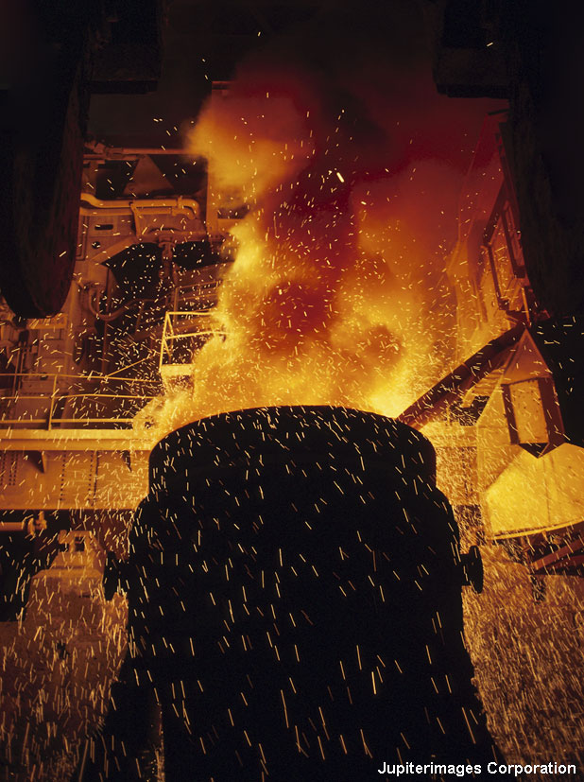
Exothermic reactions
Exothermic reactions release thermal energy (heat) into their surroundings. Exothermic reactions can occur spontaneously and some are explosive.
What are some examples?
combustion
respiration
neutralization of acids with alkalis
reactions of metals with acids
the Thermit Process.
Notes:
Photo credit: Jupiterimages Corporation
Teacher notes
The Thermit Process is a displacement reaction between aluminium and iron oxide, and is used in welding iron and steel.
See the ‘Chemical Reactions’ presentation for more information on the Thermit Process.
See the GCSE Science (Chemistry) ‘Combustion and Alternative Fuels’ presentation for more information on combustion.

Slide 5

Reversible reactions and energy
Reversible reactions are exothermic in one direction and endothermic in the other direction. For example:
endothermic
hydrated
copper sulfate
anhydrous copper sulfate
+
water
CuSO₄.5H₂O
CuSO₄
+
5H₂O
exothermic
The amount of energy transferred in each direction is exactly the same.

Slide 6

Magnesium and hydrochloric acid

Slide 7

Exothermic reaction: energy transfer
What happens to energy in the reaction between magnesium and hydrochloric acid?
No external heat source is used so the heat released during the reaction must come from the reactants.
During the reaction, chemical energy in the reactants is converted to thermal energy (heat). This causes the temperature of the reaction mixture to rise.
This thermal energy is eventually lost to the surroundings and the temperature of the reaction mixture returns to normal.

Slide 8
Exothermic reaction: energy levels

Slide 9
Exothermic reactions: summary
Notes:
Teacher notes
This completing sentences activity could be used as a plenary or revision exercise on exothermic reactions. Students could be asked to write down the missing words in their books and the activity could be concluded by the completion on the IWB.

Slide 11
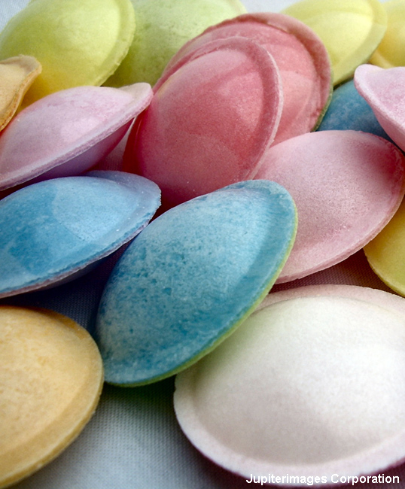
Endothermic reactions
Endothermic reactions absorb thermal energy, and so cause a decrease in temperature.
What are some examples?
thermal decomposition, e.g. calcium carbonate in a blast furnace
photosynthesis
some types of electrolysis
sherbet!
Notes:
Photo credit: Janet Goulden
Teacher notes
Endothermic reactions must absorb energy in order to proceed, and so cannot occur spontaneously. Melting, boiling, and evaporation are examples of endothermic changes of state, but not chemical reactions.
Sherbet is made from sugar, bicarbonate of soda and powdered citric acid. When the acid and bicarbonate of soda dissolve in saliva, they produce fizzing sodium citrate, water and carbon dioxide, and a cooling sensation on the tongue.

Slide 12
Ammonium nitrate and water

Slide 13

Endothermic reaction: energy transfer
What happens to energy in the reaction between ammonium nitrate and water?
During the reaction, thermal energy from the reaction mixture is converted to chemical energy in the products.
This causes the temperature of the reaction mixture to fall.
Thermal energy from the surroundings is transferred to the reaction mixture, and the temperature eventually returns to normal.

Slide 14
Endothermic reaction: energy levels

Slide 15
Endothermic reactions: summary
Notes:
Teacher notes
This completing sentences activity could be used as a plenary or revision exercise on endothermic reactions. Students could be asked to write down the missing words in their books and the activity could be concluded by the completion on the IWB.

Slide 16
Exothermic or endothermic?
Notes:
Teacher notes
Appropriately coloured voting cards could be used with this classification activity to increase class participation.

Slide 17
Energy transfer: true or false?
Notes:
Teacher notes
This true-or-false activity could be used as a plenary or revision exercise on energy transfer, or at the start of the lesson to gauge students’ existing knowledge of the subject matter. Coloured traffic light cards (red = false, yellow = don’t know, green = true) could be used to make this a whole-class exercise.

Slide 19


Making and breaking chemical bonds
Most chemicals will break up (decompose) if they are heated strongly enough. This means that energy is needed to break chemical bonds – an endothermic process.
energy
absorbed
Because bond-breaking is endothermic, bond-making must therefore be exothermic. This means that energy is released when chemical bonds are made.
energy
released

Slide 20
Bonds and exothermic reactions

Slide 21
Bonds and endothermic reactions

Slide 22
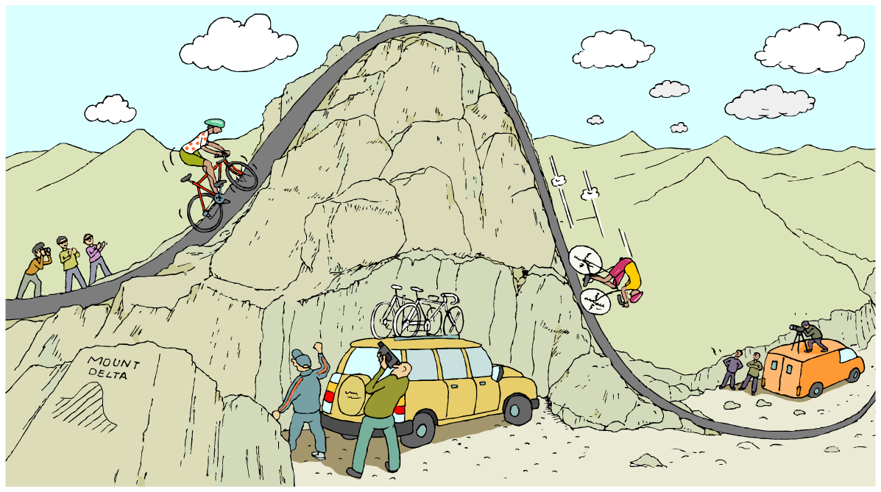
Starting reactions
Why do all reactions need some energy to start with?

Slide 23
What is activation energy?
All reactions need a certain amount of energy to get started. This is called the activation energy (E_{a}).
Activation energy is needed to start breaking the bonds of the reactants. In most chemical reactions, some existing bonds need to be broken (an endothermic process) before new bonds can be made (an exothermic process).
E_{a}

Slide 24
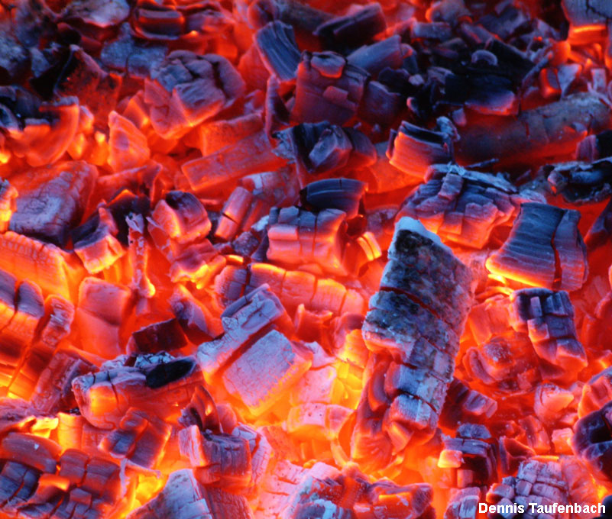
Do different reactions need different E_{a}?
In some reactions, the bonds are easily broken and a low activation energy is needed; for example, the reaction between sodium hydroxide and water starts at room temperature.
In other reactions, the bonds are strong and not easily broken. The reaction needs lots of activation energy.
An example is the combustion of charcoal (carbon) – it needs lots of heating before it will start to burn.
Notes:
Photo credit: Dennis Taufenbach

Slide 25
E_{a}: exothermic reactions

Slide 26
E_{a}: endothermic reactions

Slide 27
Bond energies
The amount of energy needed to break or make a bond is called the bond energy.
Different chemical bonds have different bond energies. For example:
Bond
energy (kJ)
Bond
H – H
432
Cl – Cl
240
H – Cl
428
The energy changes in a reaction can be calculated from the bond energies of the reactants and the products.
Notes:
Teacher notes
Bond energies taken from ‘The Elements, third Edition’ 1998, John Emsley. Clarendon Press, Oxford.

Slide 28
Calculating bond energies
What are the energy changes in the reaction between hydrogen and chlorine?
hydrogen
+
chlorine
➔
hydrogen chloride
H₂
+
Cl₂
➔
2HCl
energy for bond-breaking
energy from bond-making
= H – H + Cl – Cl
= H – Cl + H – Cl
= 432 kJ + 240 kJ
= 428 kJ + 428 kJ
= 672 kJ
= 856 kJ
total energy change
= energy out – energy in
= 856 kJ – 672 kJ
= 184 kJ
Notes:
Teacher notes
Is the total energy change for the reaction endothermic or exothermic?

Slide 29
Energy level diagram for H₂ + Cl₂

Slide 30
True or false?
Notes:
Teacher notes
This true-or-false activity could be used as a plenary or revision exercise on bonds and activation energy, or at the start of the lesson to gauge students’ existing knowledge of the subject matter. Coloured traffic light cards (red = false, yellow = don’t know, green = true) could be used to make this a whole-class exercise.

Slide 32
Glossary
activation energy – The amount of energy needed to start a reaction.
bond-breaking – A process that requires energy and so is endothermic.
bond-making – A process that releases energy and so is exothermic.
bond energy – The energy needed to break a bond, or released when a bond is made.
endothermic – A type of reaction that absorbs thermal energy.
exothermic – A type of reaction that releases thermal energy.

Slide 33
Anagrams

Slide 34
Exothermic or endothermic
Notes:
Teacher notes
Appropriately coloured voting cards could be used with this classification activity to increase class participation.

Slide 35
Multiple-choice quiz
Notes:
Teacher notes
This multiple-choice quiz could be used as a plenary activity to assess students’ understanding of energy transfer. The questions can be skipped through without answering by clicking “next”. Students could be asked to complete the questions in their books and the activity could be concluded by the completion on the IWB.

