Slide 1
Chapter 17: Thermochemistry
Section 17.1: The Flow of Energy
Section 17.2: Measuring & Expressing Enthalpy Changes
Section 17.3: Heat in Changes of State
Section 17.4: Calculating Heats of Reactions

Slide 2
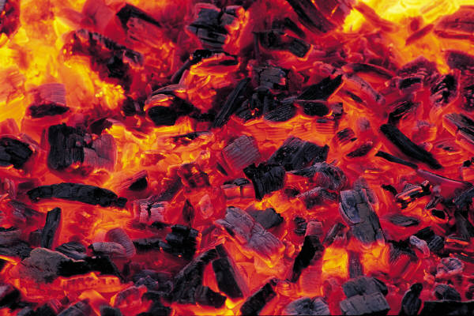
Thermochemistry and Thermodynamics
Notes:
ASSIGN READING!!!!!!!!!!!!!!!!!!!!!!!!!!!!!!!!!!!

Slide 3
We will learn:
How to calculate the amount of heat released/absorbed by a chemical reaction
Ex. – Calories in Food
The effect of that heat on the surroundings
I.e. How much heat is needed to get a change in temperature or a change of state. Ex. Refrigeration

Slide 4
What is Thermochemistry?
Study of energy changes and changes in state that occur during chemical reactions
Fuel is burned in a car engine this is chemical potential energy being released and used to do work
Chemical potential energy is energy stored in the chemical bonds of a substance

Slide 5
We are studying the transformation of energy
Chem Potential
Energy – Bond
energy
kinetic-
HEAT
or Light
Energy is always conserved but can be transformed
Notes:
When the heat of a substance changes during a rxn w/o a heat exchange with the surroundings the energy came from (or went into) the CPE (internal energy or bond energy) of the chemicals themselves

Slide 6
Heat
(q)
Transfer of energy from one object or another because of a temperature difference
Heat always flows from a warmer object to a cooler object

Slide 7
Terminology of Thermo (HEAT)
ENDO – In
Endothermic rxns absorb energy
Energy + NH₄NO₃ → NH₄⁺ + NO₃⁻
EXO – Out
Exothermic rxns release energy
H₂SO₄ → 2H⁺ + SO₄⁻² + energy
Notes:
Show reactions; DEMO!!!!!!!!!!!!!!!!!!!!!!!!!!!!!!

Slide 8
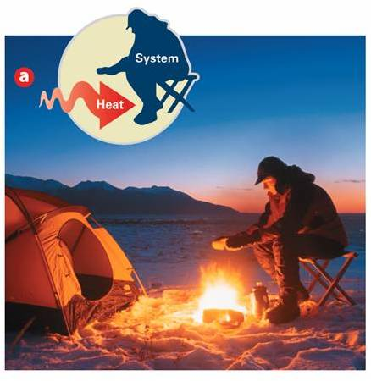
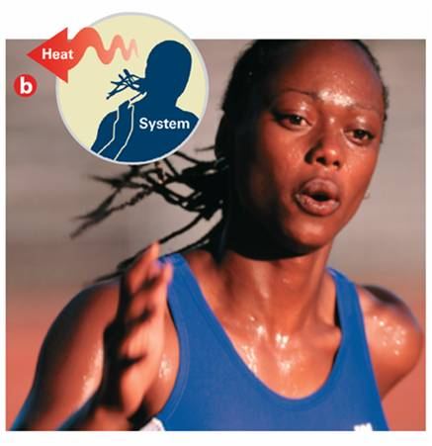
Endothermic Process
Exothermic Process
Absorbs heat / uses heat
Needs energy to happen
q is positive
Heat is produced / gives off heat
Does not need energy to happen
q is negative
Energy is a reactant
Energy is a product

Slide 9
System: part of universe you are looking at
Surroundings: everything else in universe

Slide 10
System and Surroundings
The “system” is the reaction
“Surroundings” is the environment in which the reaction takes place
Ex: Exothermic dissolving of H₂SO_{4.}
H₂SO₄ is the system
H₂O that it dissolves in is the surroundings.

Slide 11
Law of Conservation of Energy
Energy is not created or destroyed
during a chemical or physical process.

Slide 12
Units for Measuring Heat Flow
calorie (c)
The quantity of heat that raises the temperature of 1 gram of pure water
Joule
SI unit of energy
1J = 0.23490 cal
4.184 J = 1 cal
Calorie- food
calorie- lab
1 Calorie =
1000 calories
10 g sugar has 41 Calories means
10 g sugar release 41,000 calories

Slide 13
Heat Capacity
Amount of heat needed to change an objects temperature exactly 1°C
Depends on:
Mass &
Chemical composition
Specific Heat Capacity
The amount of heat it takes to raise the temperature of 1 g of a substance 1°C
units:
J/(g∙°C)
cal/(g∙°C)

Slide 14
Specific Heat Capacity
Formula
C : specific heat
q : heat (joules)
m: mass (grams)
∆ T: change in temperature (ºC)
C = q
m ∙ ∆ T

Slide 15
Example
The temperature of a 95.4 g piece of copper increases from 25°C to 48°C when the copper absorbs 849 J of heat. What is the specific heat of copper?
C = q
m ∙ ∆ T
C = 849 J
95.4g ∙ (23°C)
C = 0.39 J
g °C
q = 849 J
m = 95.4 g
∆ T= 48°C - 25°C= 23°C
C = ?
C : specific heat
q : heat (joules)
m: mass (grams)
∆ T: change in temp (ºC)

Slide 16
Example
Practice Page 510 # 3
When 435J of heat is added to 3.4 g of olive oil at 21°C, the
temperature increases to 85°C. What is the specific heat of the
olive oil?
C = q
m ∙ ∆ T
C = 435 J
3.4g ∙ (64°C)
C = 2.0 J / (g∙°C)
q = 435 J
m = 3.4 g
∆ T= 85°C - 21°C = 64°C
C = ?
C : specific heat
q : heat (joules)
m: mass (grams)
∆ T: change in temp (ºC)

Slide 17
Water has a high specific heat capacity
Why spray orange trees with water to protect the fruit
from frost damage during cold weather?
As water freezes, it releases heat, this helps prevent the fruit from freezing.

Slide 18
Your Turn
Page 510 # 4
How much heat is required to raise the temperature of 250.0 g of mercury 52°C?
C = q
m ∙ ∆ T
m ∆ T C = q
q = 250.0g x 52 ºC x 0.14 J / g ºC
q = 1820 J
q = 1800 J
q = 1.8 kJ
C : 0.14 J / g ºC
q : ? heat (joules)
m: 250.0 g
∆ T: 52 ºC
C : specific heat
q : heat (joules)
m: mass (grams)
∆ T: change in temperature (ºC)

Slide 19
Your Turn
Page 510 # 9
How much heat does 32.0g water absorb when it is heated from 25ºC to 80.0ºC?
q = ?
C = 4.18 J/(g°C )
m = 32.0 g
T = 80°C – 25°C = 55°C
q = m C T
q = 32.0 g x 4.18 J/(g°C ) x 55°C
q = 7356.8J
7400 J
7.4 kJ
C : specific heat
q : heat (joules)
m: mass (grams)
∆ T: change in temperature (ºC)

Slide 20
How do we measure the energy (heat) absorbed/released by reactions?

Slide 21
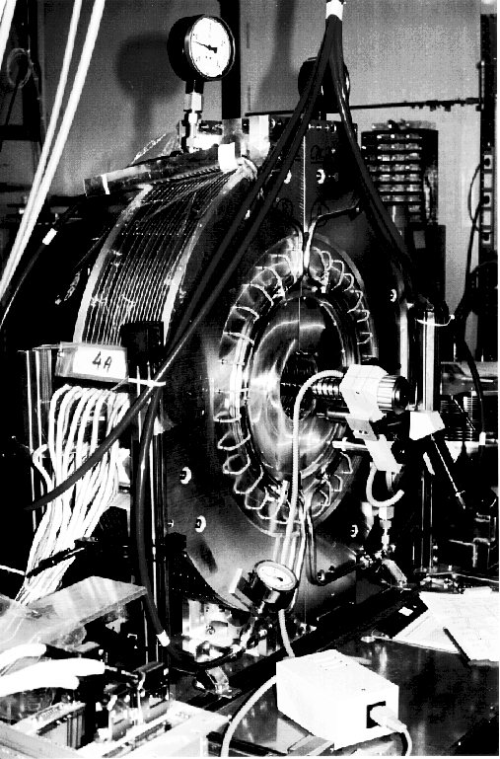
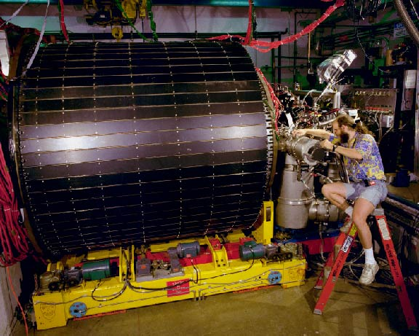
CALORIMETRY is used to measure the heats of reaction

Slide 22
Calorimetry is used to find heat capacities and heat of reaction
You measure how much heat energy (∆H) is exchanged
by measuring the change in water temp (∆T) thru ∆H = mC∆T

Slide 23
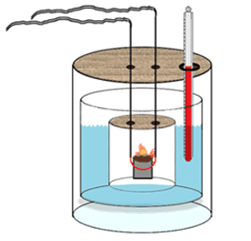
∆H_{rxn} is measured by absorbing or releasing energy from a water jacket surrounding a reaction
Notes:
Show a calorimeter

Slide 24
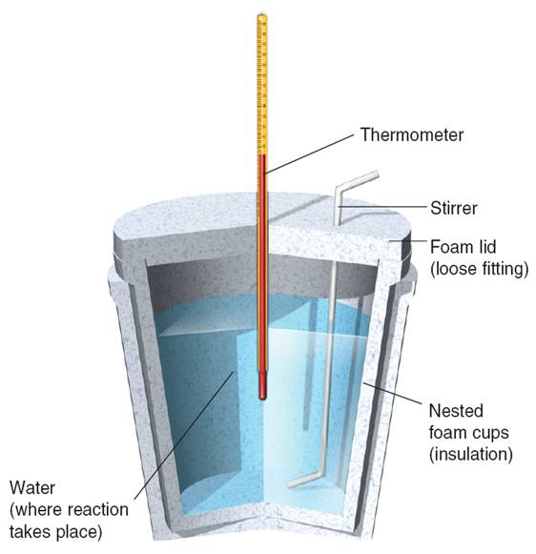
Calorimetry: Accurate & precise measurements of the amount of heat change for chemical or physical processes
Calorimeters: Devices used to measure the amount of heat absorbed or released

Slide 25
Enthalpy (H)
heat content for systems @ constant pressure
∆ H is changes in enthalpy
∆ H = q
∆ H : Endothermic
-∆ H : Exothermic
∆ H = m ∙ C ∙ ∆ T
Change in
Temperature
Enthalpy
(Heat)
Specific heat
Mass

Slide 26
+∆H and -∆H
System
+∆H = energy in (endo)
Surroundings
-∆H = energy out (exo)

Slide 27
Sign of ∆H
+∆H | endothermic
-∆H | exothermic

Slide 28
When 25.0 ml of water containing 0.025 mol HCl at 25.0 °C is added to 25.0 ml of water containing 0.025 mol NaOH at 25.0 °C in a foam cup calorimeter, a reaction occurs.
The highest temperature observed is 32.0 °C, what is the enthalpy change in kJ?
∆ H = - (m ∙ C ∙ ∆ T)
C = ?
∆ T = ?
m = ?
density of water = mass / vol

Slide 29
∆ H = - (m ∙ C ∙ ∆ T)
C = ?
∆ T = ?
m = ?
density of water = mass / vol
mass:
V_{final} = V_{HCl} + V_{NaOH} =
25.0 ml + 25.0 ml =
50 ml
Density_{solution} = 1.00 g/ml
m = 50ml ∙ 1.00 g/ml = 50 g
∆ H = -( m ∙ C ∙ ∆ T)
= -50g ∙ 4.18 J/(g∙°C) ∙7.0 °C
= -1463 J = -1.5 kJ
It is exothermic
C_{water} = 4.18 J/(g∙°C)
T_{i} = 25.0 °C
T_{f} = 32.0 °C
∆ T = T_{f} -T_{i}
= 32 – 25 = 7.0 °C

Slide 30
Example: HEAT VS. TEMPERATURE Adding the same amount of heat to different amounts of water will give you different temperatures.
Notes:
For instance adding the same amount of H2SO4 to different volumes will have different temperature rises. That is why they say add acid to water instead of the other way around.

Slide 31
Two volumes of water with the same temperature but different masses, which has more heat?
Notes:
How many ice cubes could you melt with a cup of coffee compared to a pot of coffee. Simple, but often forgotten when thinking about science

Slide 32
Thermochemical Equations
In a chemical equation, the enthalpy change ( H) for the reaction can be written as a reactant or product.
A chemical equation that includes the enthalpy changes is a thermochemical equation.
Heat of reaction is the enthalpy change

Slide 33
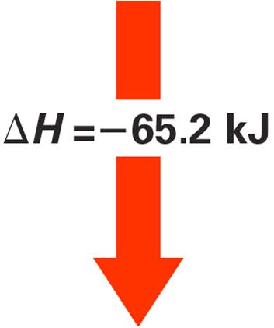
What does it mean?
CaO_{(s)} + H₂O_{(l)} → Ca(OH)_{2(s)} ∆ H = -65.2kJ
Each mole of calcium oxide reacts with 1 mole of water to release 65.2 kJ of heat
-65.2 kJ means it is exothermic

Slide 34
Heat of Combustion
The heat of reaction for the complete burning of 1 mol of a substance
CH_{4(g)} + 2O _{2(g)} → CO_{2(g)} + 2H₂O_{(l)}
∆H = -890 kJ
The heat of combustion for methane (CH₄) is -890 kJ
Is the combustion of methane
endothermic or exothermic?
Exothermic (∆H is NEGATIVE)

Slide 36
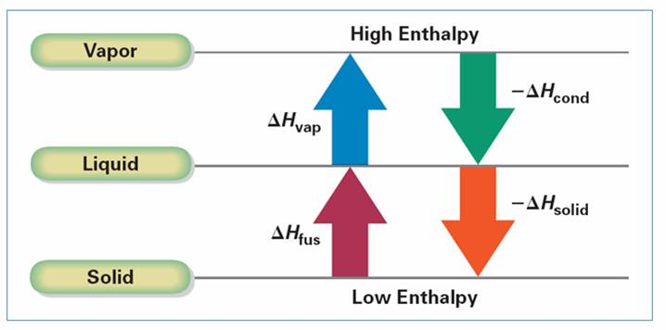
Heat & Changes In state
All solids absorb heat when they melt to liquid
When ever a state change happens,
the temperature of the substance stays constant.
(0ºC solid ice AND 0ºC liquid water)

Slide 37
∆H_{vap}
Molar heat of vaporization
The heat absorbed by 1 mole of a substance when it changes from a liquid to a vapor @ constant temperature
∆H_{cond}
Molar heat of condensation
The heat released when one mol of a vapor changes to a liquid @ constant temperature
ex: 1 mol water @ 100°C yields 1 mol vapor @ 100°C absorbs 40.9 kJ of heat
∆H_{vap} = 40.9 kJ
Ex: 1 mol vapor @ 100°C yields 1 mol water @ 100°C releases 40.9 kJ of heat
∆H_{cond} = -40.9 kJ

Slide 38
∆H_{solid}
∆H_{fus}
Molar heat of solidification
The heat released when one mol of a liquid changes to a solid @ constant temperature
Molar heat of fusion
The heat absorbed by 1 mole of a substance when it melts @ constant temperature
Ex: 1 mol ice @ 0°C yields 1 mol water @ 0°C absorbs 6.01 kJ of heat
∆H_{fus} = 6.01 kJ
Ex: 1 mol water @ 0°C yields 1 mol ice @ 0°C releases 6.01 kJ of heat
∆H_{solid} = -6.01kJ

Slide 39
∆H_{vap}
Molar heat of vaporization
The heat absorbed by 1 mole of a substance when it changes from a liquid to a vapor @ constant temperature
∆H_{cond}
Molar heat of condensation
∆H_{solid}
The heat released when one mol of a vapor changes from a vapor to a liquid @ constant temperature
∆H_{fus}
Molar heat of solidification
The heat released when one mol of a liquid changes to a solid @ constant temperature
Molar heat of fusion
The heat absorbed by 1 mole of a substance when it melts @ constant temperature

Slide 40
Remember Energy is Conserved
The heat absorbed = heat lost
∆H_{vap}= -∆H_{cond}
∆H_{fus}= -∆H_{solid}

Slide 41
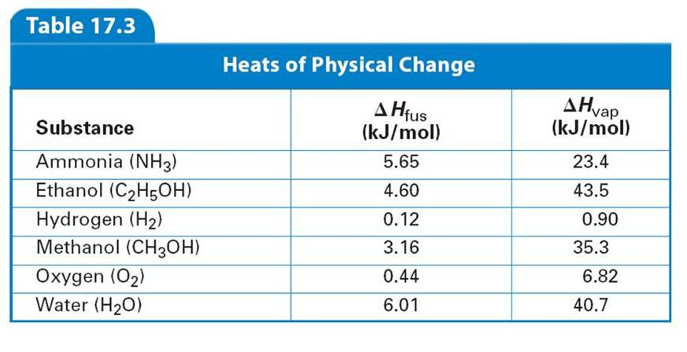

Slide 42
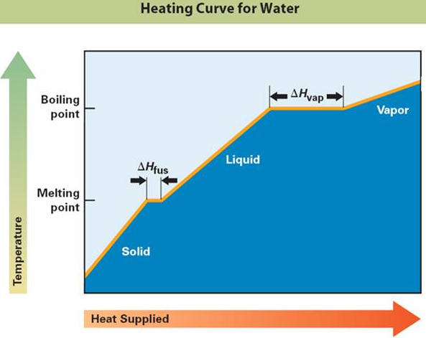
In which region is the temperature constant?
How does the amount of energy required to melt a given mass of ice compare to the energy required to vaporize the same mass of liquid water?
Which region represents the coexistence of liquid and solid?
Liquid and vapor?

Slide 43
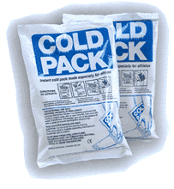
Heat of solution
∆H_{soln} (The heat change caused by the disassociation of 1 mol of a substance)
During the formation of a solution heat is either released or absorbed

Slide 44
Heat of solution
Hot pack: Exothermic: CaCl₂ mixes with water (heat is produced)
Cold pack: Endothermic: NH₄NO₃ mixes with water (heat is absorbed)

Slide 45
Hess’s Law
Add 2 or more thermo chemical equations to give a final equation,
then add the H (heats of reaction) to give the total heat change (total H)
You can write the reverse of a thermo chemical equation
but you must change the sign of the H

Slide 46
Hess’s Law WHY?
Formation Reaction Enthalpies Data can be used to build enthalpy data for unknown reactions.
This saves $, effort and makes data manageable.

Slide 47
Example: Conversion of a diamond → graphite
C_{(s, graphite)} + O_{2(g)} → CO_{2(g)} ∆H = -393.5 kJ
b. C_{(s,diamond)} + O_{2(g)} → CO_{2(g)} ∆H = -395.4 kJ
Write equation a in reverse to give:
c. CO_{2(g)} → C_{(s, graphite)} + O_{2(g)} ∆H = +393.5 kJ
Now add b. and c.
C_{(s,diamond)} + O_{2(g)} → CO_{2(g)} ∆H = -395.4 kJ
CO_{2(g)} → C_{(s, graphite)} + O_{2(g)} ∆H = +393.5 kJ
C_{(s,diamond)} → C_{(s, graphite)} ∆H = -1.9 kJ

Slide 48
Page 532 # 35
Calculate enthalpy change (∆H) in kJ for the following reaction.
2Al_{(s)} + Fe₂O_{3(s)} → 2Fe + Al₂O_{3 (s)}
Use the following
2Al_{(s)} + 2/3 O_{2(g)} → Al₂O_{3 (s)} ∆H = -1669.8 kJ
2Fe_{(s)} + 2/3 O_{2(g)} → Fe₂O_{3 (s)} ∆H = -824.2 kJ
Reverse the Iron oxide equation then add together
Fe₂O_{3 (s)} → 2Fe_{(s)} + 2/3 O_{2(g)} ∆H = +824.2 kJ
2Al_{(s)} + 2/3 O_{2(g)} → Al₂O_{3 (s)} ∆H = -1669.8 kJ
2Al_{(s)} + Fe₂O_{3(s)} → 2Fe + Al₂O_{3 (s)} ∆H = -845.6 kJ exothermic

Slide 49
Again… all reactions will either release / absorb energy in the form of heat, sound, motion and/or light.

Slide 50
Home work: Read Ch 17.1 and 17.2
Directed Readings 17.1 and 17.2

Slide 51
Thermochemistry is study of energy in chemical reactions and Thermodynamics is how heat effects physical state and temperature

Slide 52
End Ch 17

Slide 53
We will learn:
How to calculate the amount of heat released/absorbed by a chemical reaction
Ex. – Calories in Food
The effect of that heat on the surroundings
I.e. How much heat is needed to get a change in temperature or a change of state. Ex. Refrigeration

Slide 54
We are studying the transformation of energy
Chem Potential
Energy – Bond
energy
kinetic-
HEAT
or Light
Energy is always conserved but can be transformed
Notes:
When the heat of a substance changes during a rxn w/o a heat exchange with the surroundings the energy came from (or went into) the CPE (internal energy or bond energy) of the chemicals themselves

Slide 55
Activity - Exploring Energy Changes
Notes:
4 grams CaCl₂ with 10 ml of water
Per group – 1 test tube, 1 dropper, test tube rack, small beaker and thermometer

Slide 56
Chemical reactions can absorb / release many forms of energy we will be concentrating on Heat Energy

Slide 57
Terminology of Thermo (HEAT)
ENDO – In
Endothermic rxns absorb energy
Energy + NH₄NO₃ → NH₄⁺ + NO₃⁻
EXO – Out
Exothermic rxns release energy
H₂SO₄ → 2H⁺ + SO₄⁻² + energy
Notes:
Show reactions; DEMO!!!!!!!!!!!!!!!!!!!!!!!!!!!!!!

Slide 58
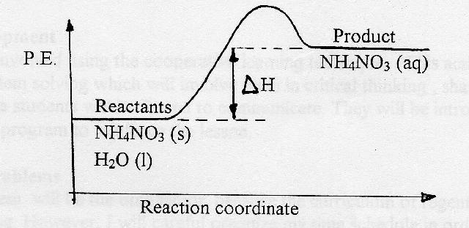
Endothermic Energy Change for Dissolving of NH₄NO₃
This energy is absorbed from the water in which the salt dissolves. The water gets cooler as a result.

Slide 59
Exothermic Energy Change for Dissolving of H₂SO₄
This energy is released to the water in which the acid dissolves. The water gets warmer as a result.

Slide 60
System and Surroundings
The “system” is the reaction
“Surroundings” is the environment in which the reaction takes place
Ex: Exothermic dissolving of H₂SO_{4.}
H₂SO₄ is the system
H₂O that it dissolves in is the surroundings.

Slide 61
+∆H and -∆H
System
+∆H = energy in (endo)
Surroundings
-∆H = energy out (exo)

Slide 62
Sign of ∆H
+∆H | endothermic
-∆H | exothermic

Slide 63
HEAT OF REACTION DEPENDS ON AMOUNT OF MATERIAL WS – Stoichiometry w/ Energy (Practice in Class)

Slide 64
What is heat?
Notes:
Heat is energy; motion of energy; lowest form of energy; most forms turn to heat and eventually spread from hot to cold

Slide 65
Heat is Molecular Motion Demo with Food Coloring and Different Temperature Water

Slide 66
How does a thermometer work?
Notes:
Fahrenheit (F) Celsius (C) Kelvin (K) - Absolute Zero

Slide 67
How do we measure the energy (heat) absorbed/released by reactions?

Slide 68
CALORIMETRY is used to measure the heats of reaction

Slide 69
Calorimetry is used to find heat capacities and heat of reaction
You measure how much heat energy (∆H) is exchanged by measuring the change in water temp (∆T) thru ∆H = mC_{p}∆T

Slide 70
∆H_{rxn} is measured by absorbing or releasing energy from a water jacket surrounding a reaction
Notes:
Show a calorimeter

Slide 71
So are heat and temperature synonyms?

Slide 72
Temperature is merely an indication of heat In addition to temperature, but to know how much heat energy there is the amount of matter and the chemical identity are needed.

Slide 73
Same Temperature but Different Types of Material
1 kg glass at 100 ºC → 240 calories heat
1 kg steel at 100 ºC →107 cal of heat
1 kg water at 100 ºC →1000 cal of heat
Notes:
Starting from zero we will get different amounts of calories at 373 K

Slide 74
Changes in temperature caused by reactions are actually measured in calorimeters with this equation ∆H = mC_{p}∆T
Notes:
We will study this reaction first and then study the heat of reaction equation

Slide 75
Quantitative Tracking of Heat
∆H = mC_{p}∆T
∆ - Change H - Heat
T – Temperature m - mass
C_{P} – Heat Capacity (type of material changing temperature)
At constant pressure (open container) ∆H = mC_{p}∆T
Notes:
Could be a change in mechanical energy also but mostly we experience heat; light is a missing term

Slide 76
Units of H and C_{p}
Variable | Units
H | kJ or cal
C_{P} | kJ/(ºC*g) cal/(ºC*g)

Slide 77
Measuring heat - heat capacity
Heat capacity C_{p} is the amount of heat energy a substance absorbs when it changes temperature.
For water Cp, = 1 cal/g ºC
= 4.184 J/g ºC
Remember that 4.184 J = 1 cal

Slide 78
Try some calculations with ∆H = mC_{p}∆T and changes in temperature

Slide 79
Different C_{p}’s Demo with Pb, Al, Zn, Fe, Cu Shot at 100 ˚C in 50 ml of water

Slide 80
Worksheet Using ∆H = mC_{p}∆T Calorimeter WS

Slide 81
Laboratory for practice with ∆H = mC_{p}∆T No reaction

Slide 82
Laboratory for practice with ∆H = mC_{p}∆T with reaction

Slide 83
It is not practical to store every heat of reaction possible in books or on the internet. Therefore, heat of reaction that you want is not always available. Do you actually have to do the experiment yourself?

Slide 84
The difference in energy/enthalpy of products & reactants (ΔH) is independent of the process. Just like differences in gravitational energy are independent of the route between the initial & final positions.

Slide 85
SR 16.1 Question #6 2C₈H₁₈ + 25O₂ → 16CO₂ + 18H₂O ΔH = -1.02 x 10⁴ kJ

Slide 86
Hess’s Law
Formation Reaction Enthalpies Data can be used to build enthalpy data for unknown reactions.
This saves $, effort and makes data manageable.

Slide 87
Hess’s Law Rules/Steps
Write down the final rxn with the correct coefficients.
Pick Heat of Formations for all the Compounds in the Rxn
Adjust rxns to get the reactants and products on the correct side w/ the correct coefficients.
Multiply rxns by any positive factor. All the coefficients & enthalpy are multiplied by factor.
Reverse direction of rxn & change sign of enthalpy.
Add compounds on same side, subtract if on opposite sides and add Enthalpies.

Slide 88
Thermochemical Data Enthalpy depends on temp. and phase. Remember ∆H˚ is for STP & the stoichiometry of the balanced rxn

Slide 89
WS USING HESS’S LAW

Slide 90
Putting it all together Practice with ∆H = C_{p}∆T with Reactions HEAT Worksheet II

Slide 91
Understanding Endothermic and Exothermic Reactions better

Slide 92
???????
With reaction
Without reaction
System
May still get cooler
System will get warmer
Heat source
Heat source

Slide 93
Endo - gets colder b/c it is turning its and surrounding heat energy into bond energy.
Heat energy from outside flows into the system to keep reaction going and maybe to keep products warm.

Slide 94
-∆H exothermic
With reaction
Without reaction
System
May get warmer
Heat source
System will get
cooler
Heat source
Notes:
Forming of rain

Slide 95
T/F: When it snows, it warms up. Where do Hurricanes get there power? Why can I burn paper with water? (Demo)

Slide 96
We know how to measure the energy of a temperature change but what about a phase change?

Slide 97
Heat can also cause changes in phase according the formula.
∆H = m ∆Hº_{f}
∆H = m ∆Hº_{b}

Slide 98
Worksheet Using ∆H = mC_{p}∆T, ∆H = m ∆H_{b} and ∆H = m ∆H_{f}

Slide 99
Energy References
Using 1 cal = 4.19 J
∆H = m ∆H_{f} , Melting 1 L Water → 335,200 J or 335 kJ
∆H = mC_{p}∆T, Increasing Temp (0 to 100 C) → 418,400 J or 418 kJ
∆H = m ∆H_{b,} Boiling 1 L Water → 2,262,000 J or 2,262 kJ

Slide 100
END

Slide 101
Enthalpy and Entropy – Spontaneity p 495 Dorin, Dabel, Gabel
Heat (Enthalpy) | Entropy | Spontaneity
+ | + | Depends
+ | - | Nope
- | + | Yup
- | - | Depends

Slide 102
What do we already know about Heat????????

Slide 103
Heat (energy)
is always needed to start a rxn
can help dissolving (mixing)
can change phase of substance (melting/freezing, boiling/condensing)
speeds reactions up or slows them down (Kinetics)

Slide 104
What does it mean?
What would be the heat released if 2.24 mol of Ca(OH)_{2(s)} are produced?
2.24 mol Ca(OH)_{2(s)}
1
-65.2 kJ
1 mol Ca(OH)_{2(s)}
x
= -146 kJ

Slide 105
Always include state change
H₂O_{(l)} → H_{2(g)} + ½O_{2(g)} ∆H = 285.8 kJ
H₂O_{(g)} → H_{2(g)} + ½O_{2(g)} ∆H = 241.8 kJ
It takes 44.04 kJ
more to convert from liquid to gas
that is why the state of change is important

Slide 106
Examples
Page 516 # 14
When carbon disulfide is formed from its elements, heat is absorbed. Calculate the amount of heat (kJ) absorbed when 5.66g of carbon disulfide is formed.
C_{(s)} + 2S_{(s)} → CS_{2(l)} ∆H = 89.3 kJ
5.66 g CS₂
1 mol CS₂
76.2 g CS₂
+6.63 kJ
89.3 kJ
1 mol CS₂

Slide 107
Examples
Page 516 #15
The production of iron & carbon dioxide from iron(III) oxide and
carbon monoxide is an exothermic reaction. How many
kilojoules of heat are produced when 3.40 mol Fe₂O₃ reacts with
and excess of CO?
Fe₂O_{3(s)}+3CO_{(g)} → Fe_{(s)}+3CO_{2(g)} ∆H = -26.3 kJ
3.40 mol Fe₂O₃ -26.3 KJ -89.4 KJ
1 1 mol Fe₂O₃

Slide 108
Examples: Page 521 # 21
How many kilojoules of heat are required to melt a 10.0 g
popsicle at 0°C? Assume the popsicle has the same molar
mass and heat of fusion of water.
10 g H₂O
1 mol H₂O
18 g H₂O
6.01 kJ
1 mol H₂O
3.34 kJ

Slide 109
Examples: Page 521 # 22
How many grams of ice at 0°C could be melted by
the addition of 0.400kJ of heat?
0.400kJ
1
1mol H₂O
6.01 kJ
18.0g H₂O
1 mol H₂O
1.20 g of ice

Slide 110
Your Turn: Page 524 # 23
How much heat is absorbed when 63.7 g H₂O_{(l)} at 100°C and
101.3 kPa is converted to steam at 100°C? Express your
answer in kJ.
63.7 g H₂O
1 mol H₂O
18.0 g H₂O
144 kJ
40.7 kJ
1 mol H₂O

Slide 111
Your Turn: Page 524 # 24
How many kilojoules of heat are absorbed when 0.46 g
of chloroethane (C₂H₅Cl) vaporizes at its normal boiling
point? The molar heat of vaporization of chloroethane is
26.4 kJ.
0.19
kJ
0.46 g C₂H₅Cl
1 mol C₂H₅Cl
64.45 g C₂H₅Cl
26.4 kJ
1 mol C₂H₅Cl

Slide 112
Standard Heats of Formation
∆H_{f}⁰ for a compound
= the heat change (+/-) when 1 mol of compound forms from its elements
*

Slide 113
Example
What is the standard heat of reaction for the
reaction of carbon monoxide gas with oxygen to
form carbon dioxide gas?
Step 1: Write the balanced equation
Unbalanced: CO_{(g)} + O_{2(g)} → CO_{2(g)}
Balanced 2CO_{(g)} + O_{2(g)} → 2CO_{2(g)}
Step 2: Find the ∆H_{f}⁰ for each
∆H_{f}⁰ O_{2(g)} = 0.0 kJ/mol
∆H_{f}⁰ CO_{(g)} = -110.5 kJ/mol
∆H_{f}⁰ CO_{2(g)} = -393.5 kJ/mol

Slide 114
2CO_{(g)} + O_{2(g)} → 2CO_{2(g)}
Step 3: Calculate ∆H_{f}⁰ for each taking into account the number of moles
∆H_{f}⁰ O_{2(g)} = 0.0 kJ/mol x 1 mole = 0 kJ
∆H_{f}⁰ CO_{(g)} = -110.5 kJ/mol x 2 mol = -221 kJ
∆H_{f}⁰ CO_{2(g)} = -393.5 kJ/mol x 2 mol = -787 kJ
Step 4 : ∆H⁰ = ∆H_{f}⁰_{(products)} - ∆H_{f}⁰ _{(reactants)}
∆H⁰ = -787kJ – (-221kJ) = -566kJ

